Slide 1
Python for Data Science, AI & Development

Slide 2

Course Content
Intro to python
Python basics syntax, comments, variables
data types
Print statement
User inputs
Strings, String methods
Strings (cont)
Operators (Arithmetic, Logical ...)
List, tuple, set and Dictionary
Control statement If Else
Loops
Functions
Scopes
Try & Except
File Handling
Pre-built & User Defined Modules
OOP

Slide 3
Coding & Programming is not difficult!

Slide 4
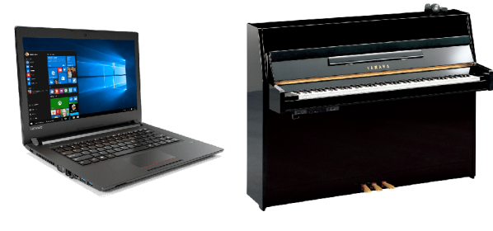
Writing code in computer vs playing notes in piano
Practice, practice and practice for coding.

Slide 5
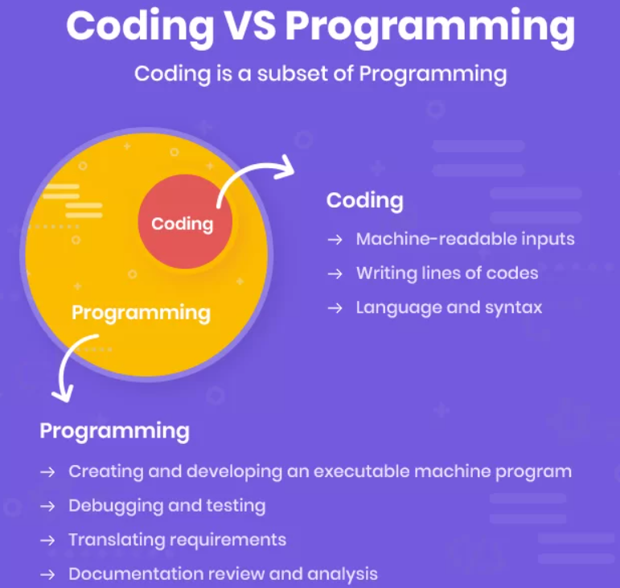

Slide 6
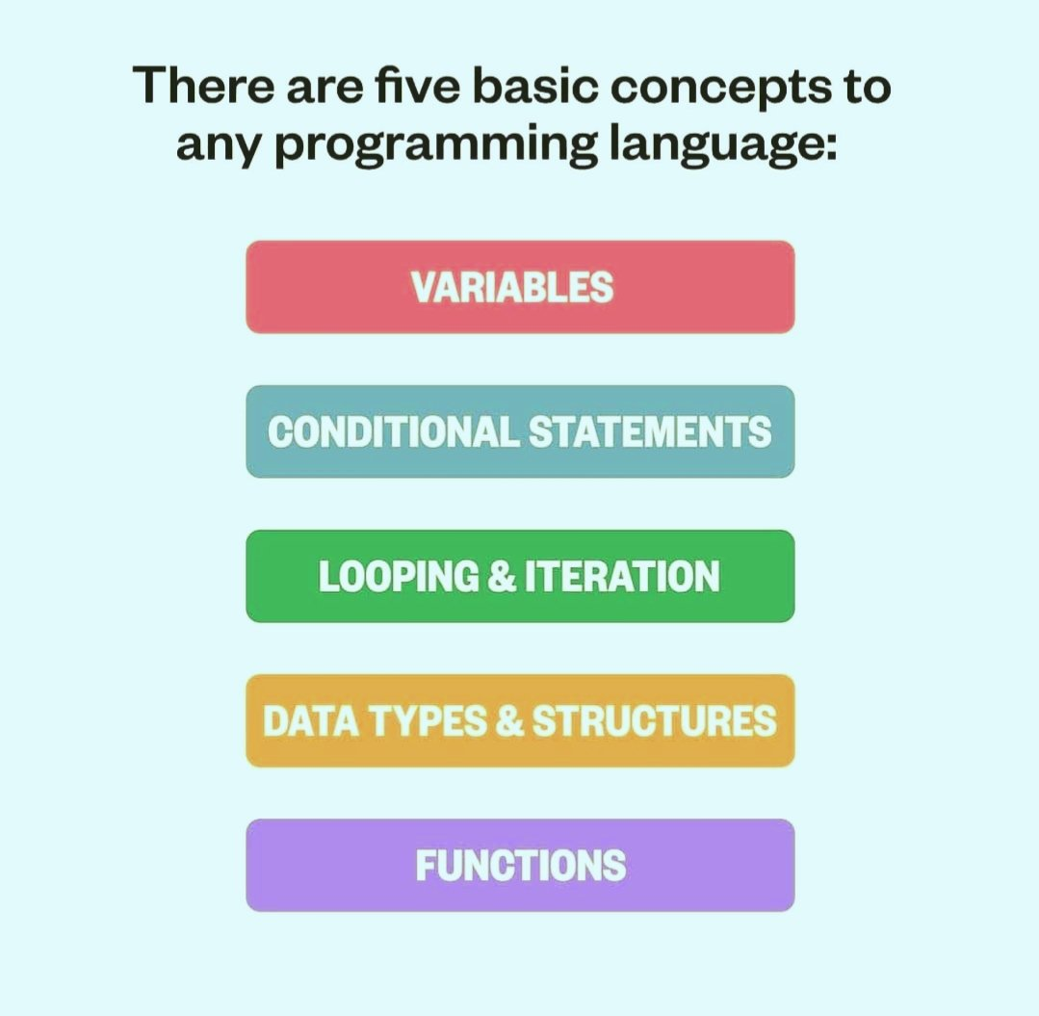

Slide 7
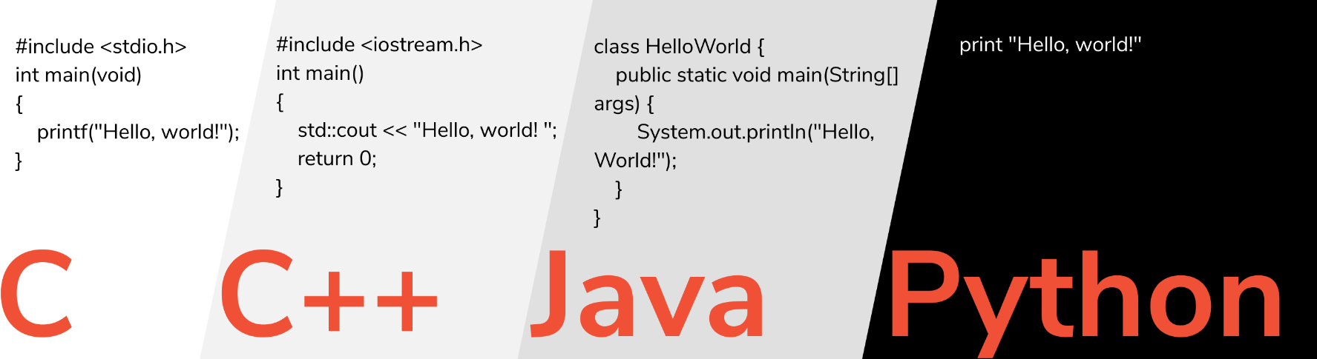
Programming Syntax:
the set of rules that defines how a programming languages will be written.
(
)

Slide 8
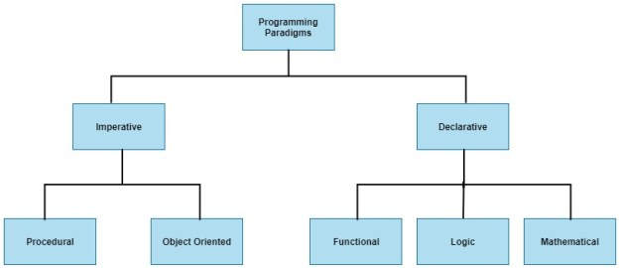
Programming paradigms:
Are a way to classify programming languages based on their features.
Sql
Select name FROM students WHERE grade > 90
Focuses on how to get there
Focuses on the result
For i in students:
If i.grade >90:
print(i.name)

Slide 9
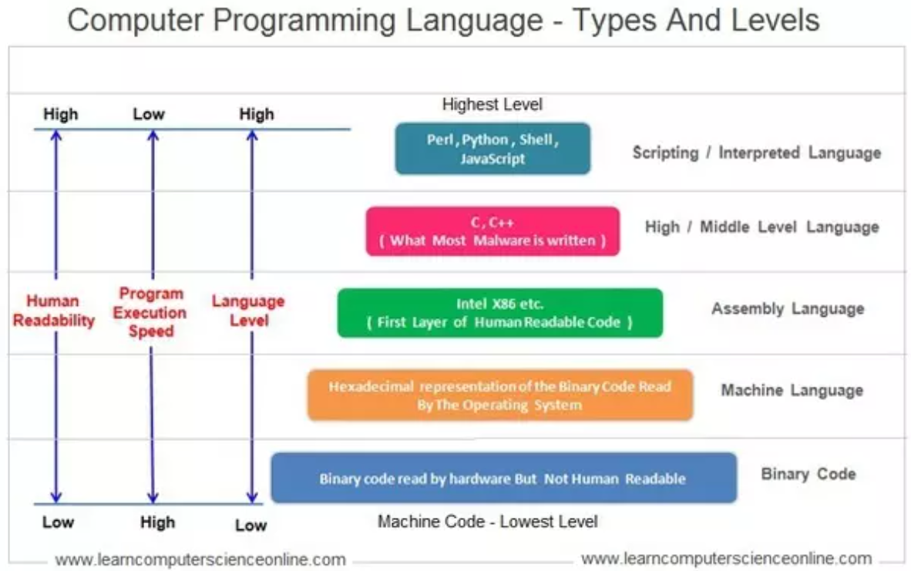
Levels of programming languages :
MOV AL , 61

Slide 10
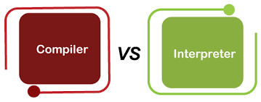
Compiler VS Interpreter : Compiler : 1. scans the entire program and translates the whole of it into machine code at once. 2. the overall time taken to execute the process is much faster. 3. C and C++ for example. - Interpreter : 1. translates just one statement of the program at a time into machine code 2. the overall time to execute the process is much slower 3. Python for example

Slide 11
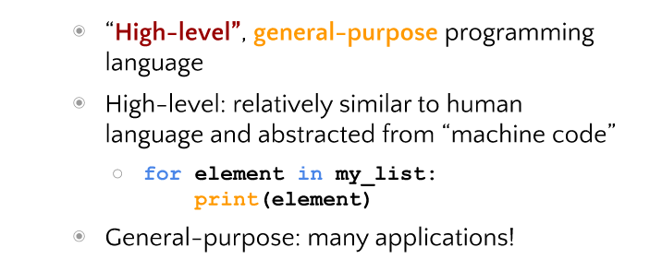
What is python ?
for(i=0; i>10;i++){
}

Slide 12
Python uses
Building desktop applications, including GUI applications, CLI tools, and even games
Doing mathematical and scientific analysis of data
Building web and Internet applications
Example:
Python programming: Reddit, Dropbox, and YouTube
Python web framework Django: Instagram and Pinterest.
Doing computer systems administration and automating tasks
Building AI applications

Slide 13
Programming branches in Python
Python Programming
Python for Science and Engineering
Python for Control Engineering
Python for Software Development
Python for Data science

Slide 14
Careers with Python
Data analyst
Data analyst
Data engineer
DevOps engineer
Software engineer
Many more other roles
Software engineer
Many more other high salary
Game developer
Web designer
Python developer
Full-stack developer
Machine learning engineer
Data scientist

Slide 15
jupyter notebook --notebook-dir="H:\DEPI ENGBARAA\python_basics"
This command launches Jupyter Notebook and sets the starting (default) folder to:
📁 E:\DEPI R3 python course
So every time you run this command, Jupyter will open directly inside that specific folder
⚠️ Important Note:
This command only changes the directory for this session. Once you close the terminal or Jupyter, it will not remember the path next time.

Slide 16
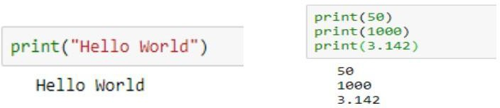
Print Statements
Since Python is one of the most readable languages out there, we can print data on the terminal by simply using the print statement.
The text Hello World is bounded by quotation marks because it is a string or a group of characters.
Next, we’ll print a few numbers. Each call to print moves the output to a new line

Slide 17
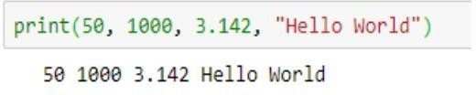
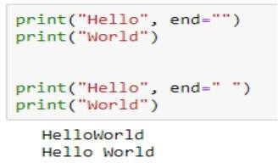
Print Statements
We can even print multiple things in a single print command; we just have to separate them using commas.
By default, each print statement prints text in a new line. If we want multiple print statements to print in the same line, we can use the following code.
The value of end is appended to the output and the next print will continue from here

Slide 18
Quiz
How can we print the text, “IBM_Data_Science”in Python?
print IBM_Data_Science
Print ” IBM_Data_Science”
print(“IBM_Data_Science”)
print(IBM_Data_Science)

Slide 19
Quiz
How can we print the text, “IBM_Data_Science”in Python?
print IBM_Data_Science
Print ” IBM_Data_Science”
print(“IBM_Data_Science”)
print(IBM_Data_Science)

Slide 20
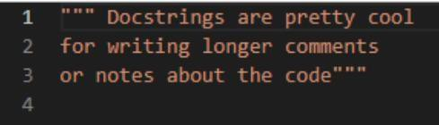
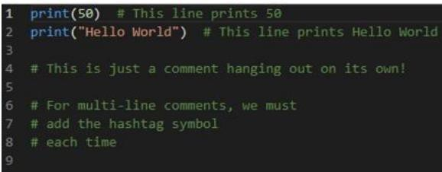
Comments
Single comment: #
Multiline comment/docstrings: between three double/single quotes “”” “””. Or you can just write # multiple times.
You can use Ctrl+ “/” to automatically comment a whole section.

Slide 21
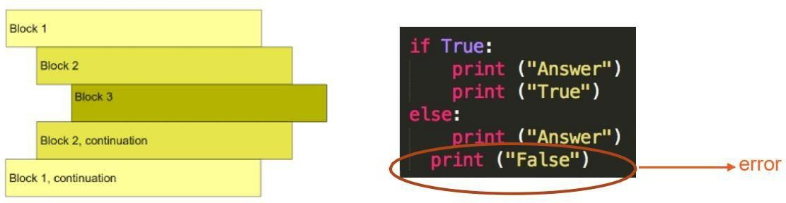
Indentation
Indentation is Important in Python. It Illustrate how code blocks are formatted.

Slide 22
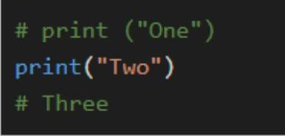
Quiz
What will be printed by the following code?
One Two Three
One Three
Two
three

Slide 23
Python Statements & Variables
Python statements means a logical line of code that can be either expression or assignment statement.
Expression means a sequence of numbers, strings, operators and objects that logically
can be valid for executing.
Simple assignment statement means a statement with its R.H.S just a value-based expression or a variable or an operation.
Augmented assignment statement means a statement where the arithmetic operator is combined in the assignment.
Notes:
A statement can be written in multi-lines by using \ character.
Multiple statements can be written in same line with ; separator.

Slide 24
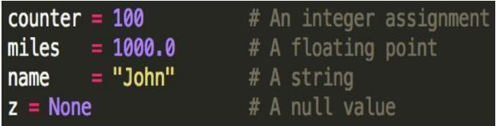
Variables
A variable is simply a name to which a value can be assigned.
Variables allow us to give meaningful names to data.
The simplest way to assign a value to a variable is through the = operator.
A big advantage of variables is that they allow us to store data so that we can use it later to perform operations in the code.
Variables are mutable. Hence, the value of a variable can always be updated or replaced.

Slide 25
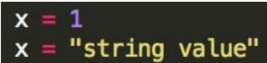
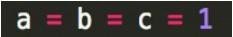
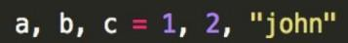
Variables
Variables can change type, simply by assigning them a new value of a different type.
Python allows you to assign a single value to several variables simultaneously.
You can also assign multiple objects to multiple variables.
Variables are Case- Sensitive: x is different from X.

Slide 26
Variables
Do not need type deﬁnition when creating a variable. In C Langauge for example, to declare a variable:
D int x = 4
In python, no need for declaring the type ‘int’
D x = 4
It knows automatically that x is an integer.

Slide 27
Identiﬁers
Python identiﬁers means the user-deﬁned name that is being given to anything in your code as the variables, function, class or any other object in your code. Guidelines for creating a python identiﬁers:
Use any sequence of lower case (a - z) or upper case (A - Z) letters in addition to numbers (0 - 9) and underscores (_).
No special characters or operators are allowed. (, ), [, ], #, $, %, !, @, ~, &, +, =, -, /, \.
Don’t start your identiﬁer with a number as it is not valid.
Some keywords are reserved as False, True, def, del, if, for, raise, return, None, except, lambda, with, while, try, class, continue, as, assert, elif, else, is, in, import, not, from global , pass, ﬁnally and yield. You can’t name an identiﬁer with these words on their own however you can use them as sub-name such as True_stat or def_cat
Make the user-deﬁned name meaningful.

Slide 28
Identiﬁers
6. Python is case sensitive language so variable1 identiﬁer is different from Variable1 identiﬁer.
Identiﬁers or user-deﬁned names has a convention in python which is as follows:
Never use l “lower-case el” or I “Upper-case eye” or O “Upper-case Oh” as single character variable name as in some fonts they are indistinguishable

Slide 29
Python Data Types

Slide 30
Data type means the format that decides the shape and bounds of the data. In python, we don’t
have to explicitly predeﬁne the variable data type but it is a dynamic typing technique. Dynamic typing means that the interpreter knows the data type of the variable at the runtime from the syntax itself.
The data types in python can be classiﬁed into:
1 – Numbers
3 – Strings
5 – Lists
7 – Tuples
9 - Dictionaries
2 - Booleans
4 - Bytes
6 - Arrays
8 - Sets

Slide 31
Any variable in python carries an instance of object which can be mutable or immutable. When an object is created it takes a unique object id that can be check by passing the variable to the built-in function id() . The type of the object is deﬁned at runtime as mentioned before.
Immutable objects can’t be changed after it is created as int, ﬂoat, bool, string, Unicode, tuple.
Mutable objects can be changed after it is created as list, dict, set and user-deﬁned classes.

Slide 32
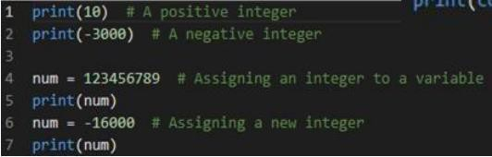
Numbers
Python is one of the most powerful languages when it comes to manipulating numerical data.
There are three built-in data types for numbers in Python:
Integer (int)
Floating-point numbers (ﬂoat)
Complex numbers: <real part> + <imaginary part>j (not used much in Python programming)

Slide 33
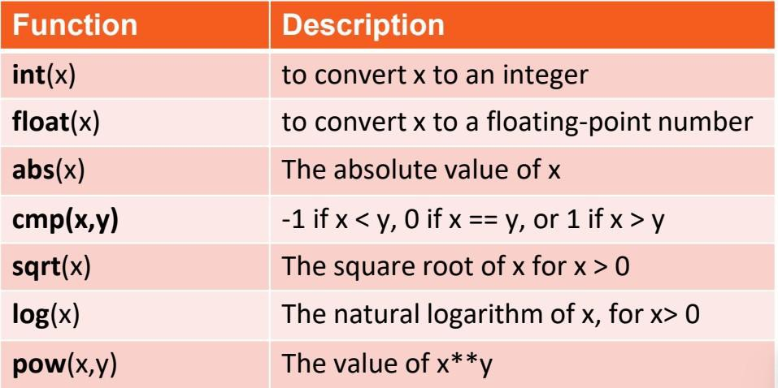
Common Number Functions

Slide 34
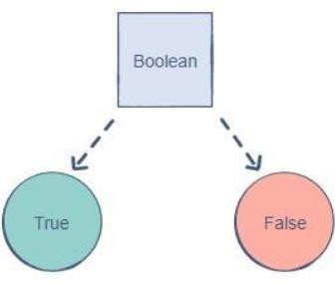
Booleans
The Boolean (also known as bool) data type allows us to choose between two values: true and false.
In Python, we can simply use True or False to represent a bool
Note: The ﬁrst letter of a bool needs to be capitalized in Python.
A Boolean is used to determine whether the logic of an expression or a comparison is correct. It plays a huge role in data comparisons.

Slide 35
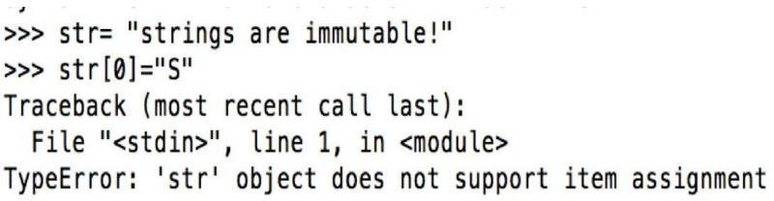
Strings
A string is a collection of characters closed within single or double quotation marks
(immutable).
You can update an existing string by (re)assigning a variable to another string.
Python does not support a character type; these are treated as strings of length one.

Slide 36
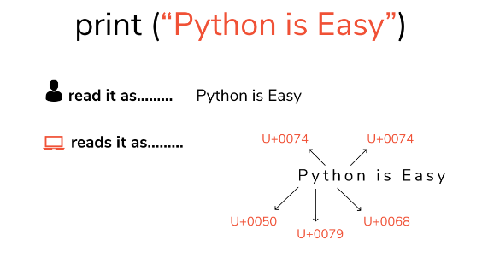

Slide 37
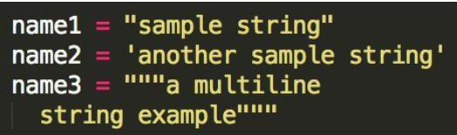
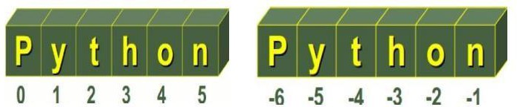
Strings
Python accepts single ('), double (") and triple (''' or """) quotes to denote string literals.
String indexes starting at 0 in the beginning of the string and working their way from -1 at the end

Slide 38
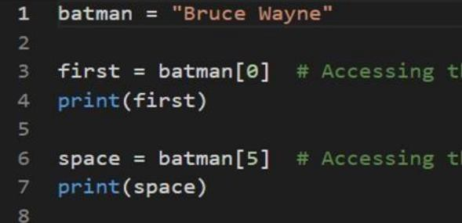
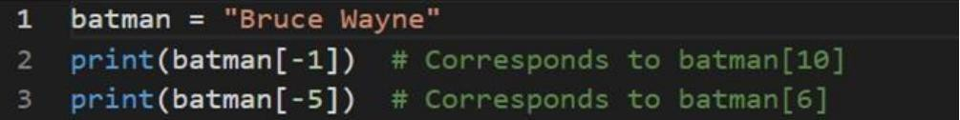
Strings Indexing
"Python for everyone"
You can index a string (access a character) by using square brackets:

Slide 39
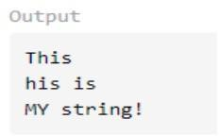
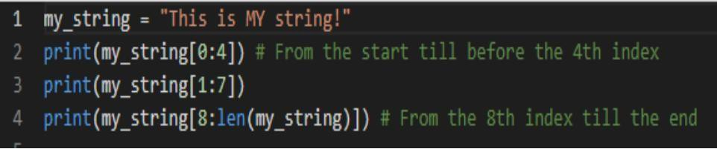
Strings Slicing
Slicing is the process of obtaining a portion (substring) of a string by using
its indices. Given a string, we can use the following template to slice it
and obtain a substring String [start:end]
start is the index from where we want the substring to start.
end is the index where we want our substring to end.
The character at the end index in the string, will not be included in the substring obtained through this method.

Slide 40
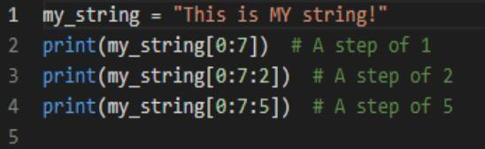
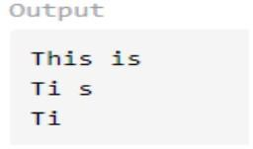
Strings Slicing with a step
Until now, we’ve used slicing to obtain a contiguous piece of a string, i.e., all the characters from the starting index to before the ending index are retrieved.
However, we can deﬁne a step through which we can skip characters in the string. The default step is 1, so we iterate through the string one character at a time.
The step is deﬁned after the end index

Slide 41
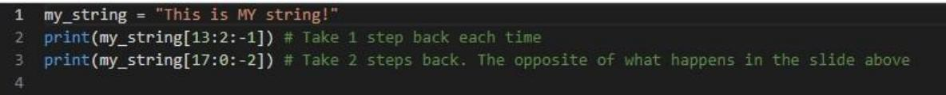
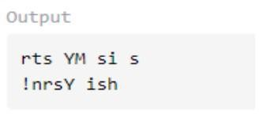
Strings Reverse Slicing
Strings can also be sliced to return a reversed substring. In this case, we would need to
switch the order of the start and end indices.
A negative step must also be provided The step is deﬁned after the end index

Slide 42
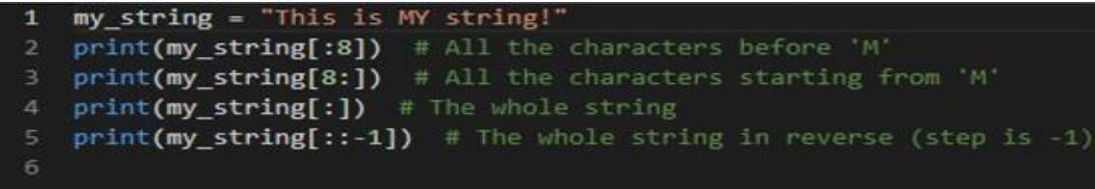
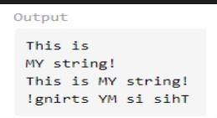
Strings Partial Slicing
One thing to note is that specifying the start and end indices is optional.
If start is not provided, the substring will have all the characters until the end index.
If end is not provided, the substring will begin from the start index and go all the way to the end.

Slide 43
Quiz
What is the output of the following code?
>>my_string = "0123456789"
>>print(my_string[-2: -6: -2])
5432
8765
532
86

Slide 44
Quiz
What is the output of the following code?
>>my_string = "0123456789"
>>print(my_string[-2: -6: -2])
5432
8765
532
86

Slide 45
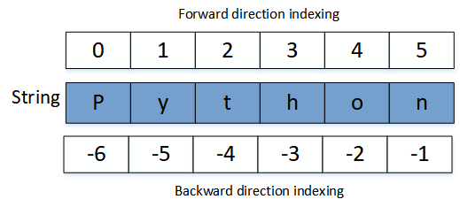

Slide 46
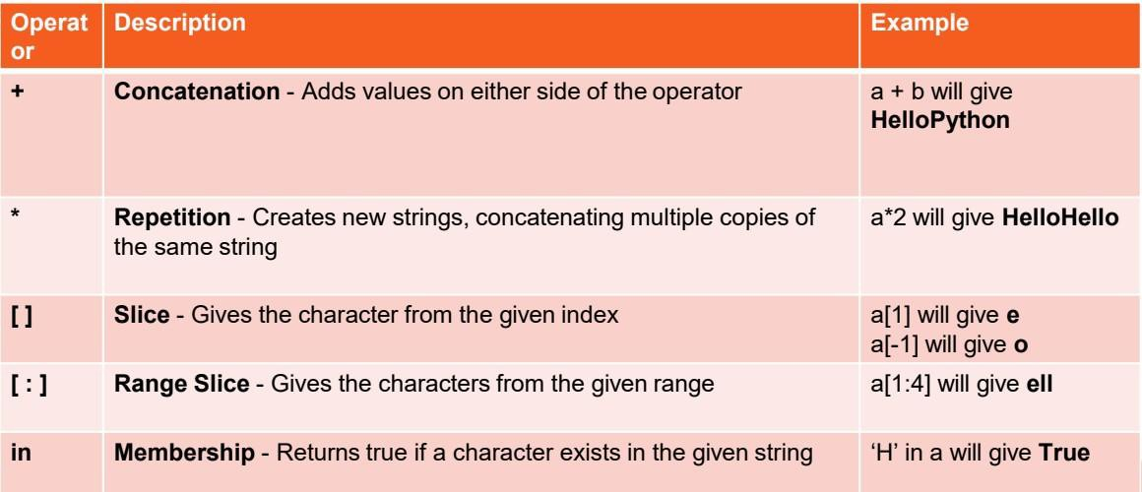
Common String Operators
Assume string variable a holds 'Hello' and variable b holds 'Python’

Slide 47
Common String Operators
Strings are an example of Python objects. An object contains both data (the actual string itself) and methods, which are effectively functions that are built into the object and are available to any instance of the object.
upper() Return a capitalized version of string
lower() Return a copy of the string converted to lowercase.
ﬁnd() searches for the position of one string within another
strip() removes white space (spaces, tabs, or newlines) from the beginning and end of a string
Other useful methods in this link
Notes:
BNS2-AIS4-A2

Slide 48
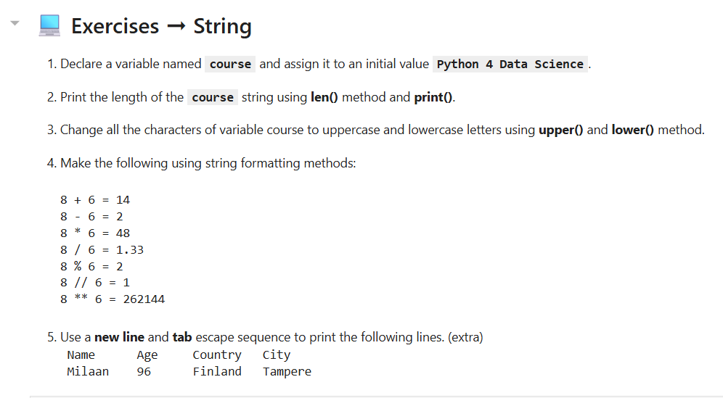

Slide 49
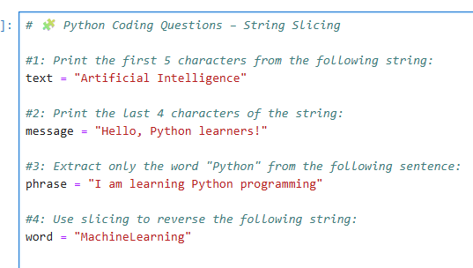
Python Coding Questions – String Slicing
Using find() and len()

Slide 50
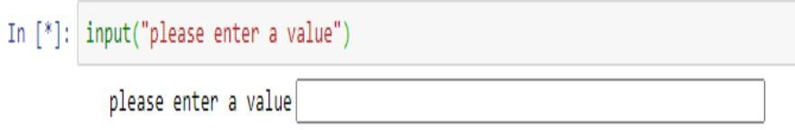
Python User Input from Keyboard
Python user input from the keyboard can be read using the input() built- in function.
The input from the user is read as a string and can be assigned to a variable.
After entering the value from the keyboard, we have to press the “Enter” button. Then the input() function reads the value entered by the user.

Slide 52
Python User Input from Keyboard
The program halts indeﬁnitely for the user input, There is no option to provide timeout value.
The syntax of input() function is: input(“prompt”)
The prompt string is printed on the console and the control is given to the user to enter the value.
You should print some useful information to guide the user to enter the expected value.

Slide 53
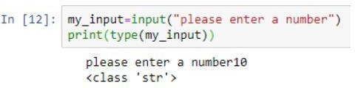
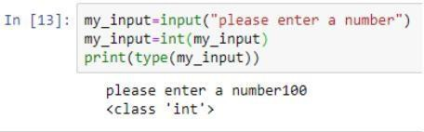
Python User Input from Keyboard
D What is the type of user entered value?
The user entered value is always converted to a string and then assigned to the variable. Let’s conﬁrm this by using type() function to get the type of the input variable.
D How to get an Integer as the User Input?
There is no way to get an integer or any other type as the user input. However, we can use the built-in functions to convert the entered string to the integer.

Slide 54
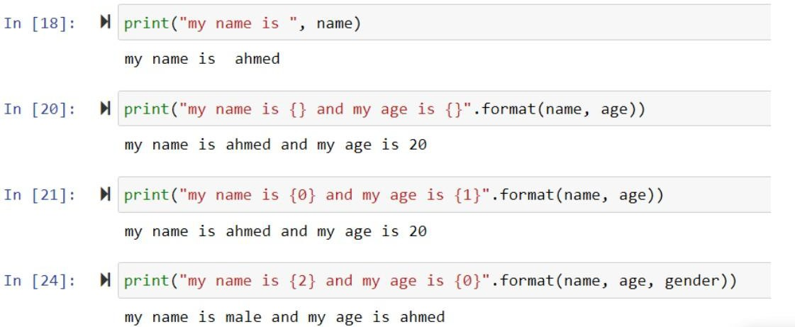
Printing Strings
D Print statement can have different formats

Slide 55
Escape Characters
Sometimes we want to print strings having special characters. So we add backslash before the special character as follows: “My name is \“Ahmed\” ”
Escape Characters:
\’: single quote
\\: Backslash
\n: New line
\t: tab
\b: Backspace

Slide 56
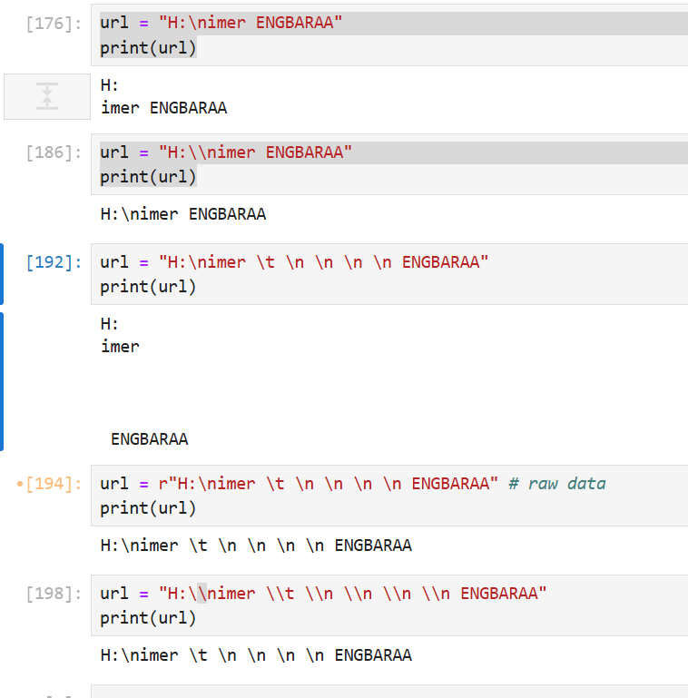

Slide 57
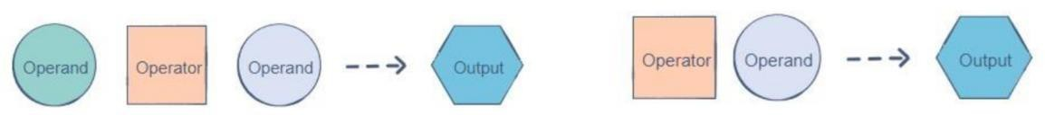
Operators
Operators are used to perform arithmetic and logical operations on data. They enable us to manipulate and interpret data to produce useful outputs.
Python operators follow the inﬁx or preﬁx notations:
The 5 main operator types in Python are:
Arithmetic - Comparison - Assignment - Logical - Bitwise

Slide 58
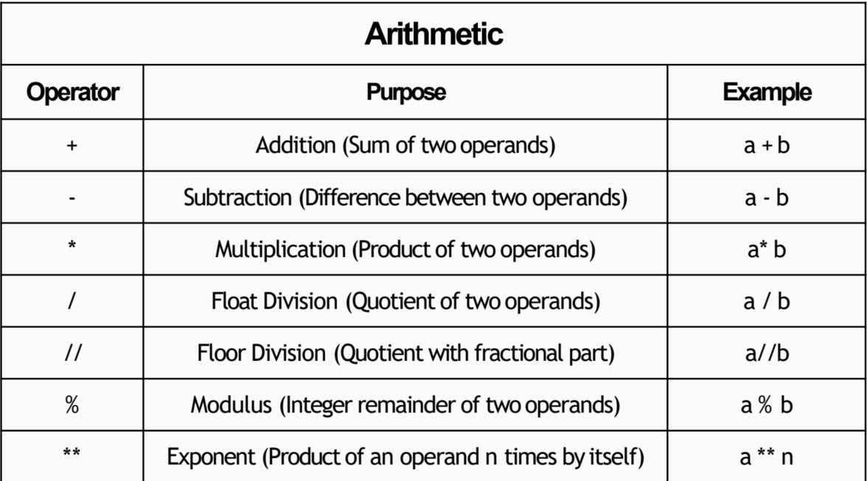
Operators

Slide 59
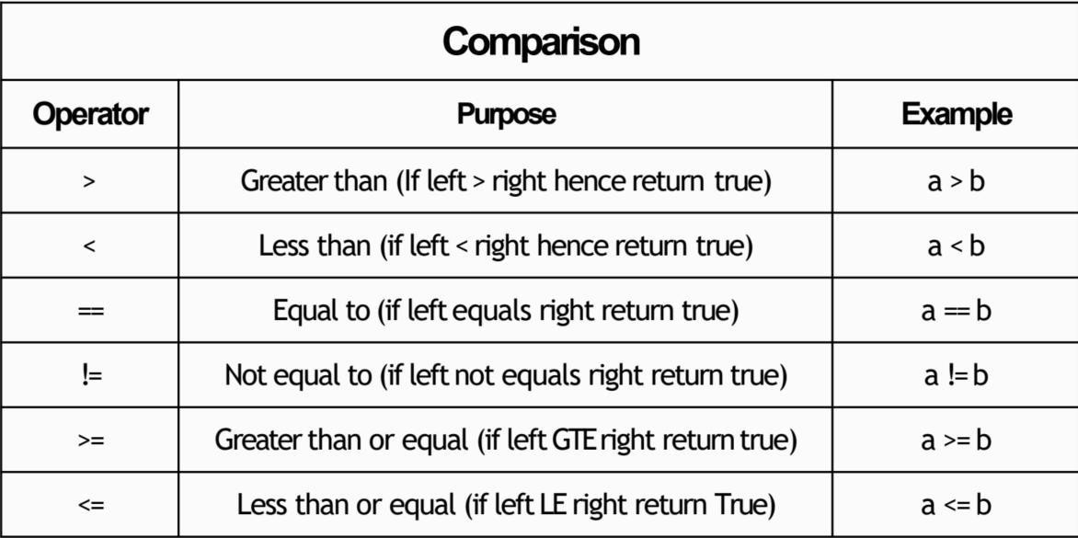
Operators

Slide 60
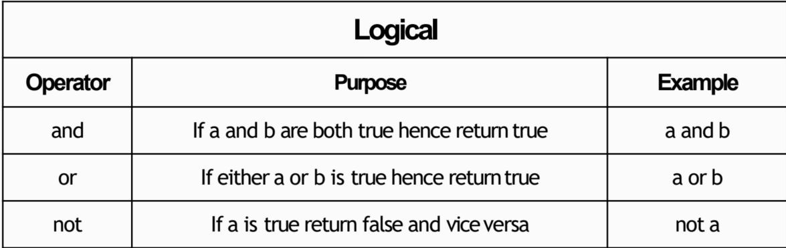
Operators

Slide 61
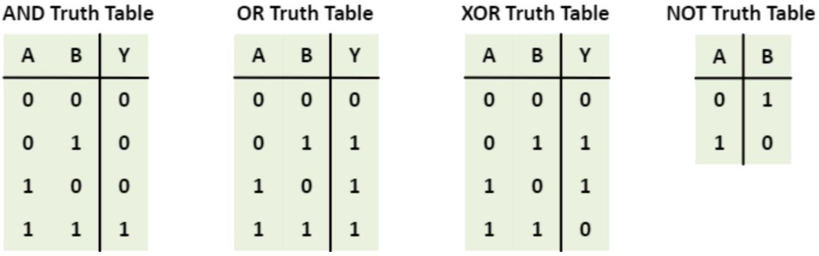
Operators
Logic Tables:

Slide 62

Operators

Slide 63

Operators

Slide 64

Quiz
What is the operator used?
OR
XOR
AND
NOT

Slide 65

Quiz
What is the output of printing ‘result’?
False
-21
5
5.25
Notes:
S10

Slide 66
Task: Simple User Input – Welcome Message
Create a simple Python program that:
Asks the user to enter their full name
Asks for their department
Asks for their age ( Make sure it's a valid number)
Then, print a friendly welcome message using an print using f format.
Use while True: to keep looping (break) Use try-except to catch invalid age inputs

Slide 67
Data Containers

Slide 69

Data Containers
Python provides several built-in data structures (or containers) to organize and manage data efficiently. These include lists, tuples, sets, and dictionaries.
Lists
A list is an ordered, mutable collection of items. Lists can contain items of different types, including other lists.
Syntax
Lists are defined using square brackets [ ]
Key Characteristics of list
Ordered: Lists allow access to items using an index.
Mutable: You can add, delete, or modify items in a list.
Non-Unique Items: Lists can contain duplicate elements.
Mixed Data Types: Lists can hold items of different data types.

Slide 70


Data Containers
Lists Operations
Indexing
Access elements using their index (starting at 0)
Slicing
Access a range of elements

Slide 71


Data Containers
Lists Operations
Adding Elements
Use append() to add an item, insert() to add at a specific index.
Removing Elements
Use remove() to delete an item, pop() to remove by index.

Slide 72


Tuples
A tuple is an ordered, immutable collection of items. Once defined, its contents cannot be changed.
Syntax
Tuples are defined using parentheses ( )
Operations
Indexing and Slicing: Similar to lists.
Immutability
Cannot change elements, which makes tuples faster for read-only data.

Slide 73
Tuples
Key Characteristics of Tuples
Ordered: Tuples allow access to items using an index.
Immutable: You cannot add, delete, or modify items in a tuple.
Non-Unique Items: Tuples can contain duplicate elements.
Mixed Data Types: Tuples can hold items of different data types.

Slide 74

Sets
A set is an unordered collection of unique items. Sets are used for membership testing and eliminating duplicate entries.
Syntax
Sets are defined using curly braces {} or the set() function
Operations
Adding Elements: Use add()

Slide 75
Sets
Key Characteristics of Sets
Unordered: Sets do not maintain a specific order of items.
No Indexing/Slicing: Sets do not support indexing or slicing operations.
Immutable Data Types: Sets can only contain immutable data types (e.g., numbers, strings, tuples).
Unique Items: Sets automatically remove duplicate items, ensuring all elements are unique.

Slide 76


Sets
Operations
Removing Elements: Use remove() or discard()
Set Operations: Union, intersection, difference.

Slide 77


Dictionaries
A dictionary is an unordered collection of key-value pairs. Keys must be unique and immutable (e.g., strings, numbers).
Syntax
Defined using curly braces { } with key-value pairs separated by colons.
Operations
Accessing Values: Use keys.
Adding/Updating: Assign a value to a key.

Slide 78

Dictionaries
Operations
Removing Items: Use pop() to remove a key-value pair.
Key Characteristics of Dictionaries
Key-Value Pairs: Dictionaries store data as key-value pairs.
Immutable Keys: Dictionary keys must be immutable (e.g., numbers, strings, tuples).
Flexible Values: Dictionary values can be of any data type.
Unique Keys: Each key in a dictionary must be unique.
Unordered: Dictionaries are not ordered; elements are accessed using keys.

Slide 79


Slide 80


Slide 81

Note: If you are not familiar with using if-else statements in Python, please skip this question.
Note:
If the length is odd, there is one middle item
And If the length is even, there are two middle items

Slide 82
Control Flow

Slide 83


Slide 84
Control Flow
Control flow statements are essential in programming as they enable the execution of specific blocks of code based on conditions. This allows for dynamic decision-making within a program. In Python, the primary control flow statements include if, elif, and else. We'll cover these concepts with detailed explanations and multiple examples to illustrate their use.

Slide 85

Control Flow
If Statements
The if statement is used to test a specific condition. If the condition evaluates to True, the code block under the if statement is executed.
Syntax

Slide 86

If Statements
Examples
Check Positive Number
This code checks if the number is greater than zero. Since 5 > 0 is true, it prints "The number is positive.

Slide 87

If Statements
Examples
Check String Length
The code checks if the length of the string name is greater than 3. Since "Alice" has 5 characters, the condition is true, and it prints "The name is longer than 3 characters."

Slide 88

If Statements
Examples
Check Membership in List
The code checks if "banana" is an item in the fruits list. Since it is, the condition is true, and it prints "Banana is in the list."

Slide 89

If Statements
Examples
Check if Variable is Not None
This code checks if result is None. Since it is, the condition is true, and it prints "Result is not set yet."

Slide 90
Control Flow
If-Else Statements
The if-else statement provides an alternative block of code that is executed if the condition is False.

Slide 91

If-Else Statements
Examples
Check Even or Odd Number
This code checks if number is even by using the modulus operator %. Since 4 % 2 == 0 is true, it prints "Even number."

Slide 92

If-Else Statements
Examples
Age Verification
The code checks if age is 18 or older. Since age is 17, the condition is false, so it prints "You are not eligible to vote."

Slide 93

If-Else Statements
Examples
Check for Empty List
The code checks if items is a non-empty list. Since items is empty, the condition is false, and it prints "The list is empty."

Slide 94

If-Else Statements
Examples
Temperature Check
This code checks if the temperature is greater than 20. Since 15 is not greater than 20, it prints "It's cold outside."

Slide 95
Control Flow
If-Elif-Else Statements
The if-elif-else statement allows checking multiple conditions sequentially. Only the block of the first True condition is executed. If none of the conditions are True, the else block is executed.

Slide 96

If-Elif-Else Statements
Examples
Grading System
This code assigns grades based on score. Since the score is 72, it matches the elif score >= 70: condition, so it prints "Grade C."

Slide 97

If-Elif-Else Statements
Examples
Traffic Light Signal
This code checks the color of traffic_light. Since it is "yellow," it matches the second condition and prints "Slow down."

Slide 98

If-Elif-Else Statements
Examples
Classify Age Group
The code classifies age into different groups. Since 35 is less than 65 but more than 18, it matches the "Adult" category and prints "Adult."

Slide 99

If-Elif-Else Statements
Examples
Check Temperature Range
The code checks which temperature range temperature falls into. Since it is 30, it matches the elif temperature <= 30: condition and prints "Warm."

Slide 100
Control Flow
Nested If Statements
If statements can be nested within other if statements to create complex conditions.

Slide 101

Nested If Statements
Examples
Permission Check with Age
This code checks if age is less than 18 and then checks if has_permission is True. Since both conditions are met, it prints "You can enter with permission."

Slide 102

Nested If Statements
Examples
Nested Condition for Shopping
This code first checks if has_discount is True and then checks if is_member is also True. Since is_member is False, it prints "You get a 10% discount."

Slide 103

Nested If Statements
Examples
Nested Temperature and Time Check
This code checks if temperature is greater than 20 and then checks if it's morning. Since both conditions are true, it prints "It's warm and morning time."

Slide 104

Nested If Statements
Examples
Bank Account Balance Check
This code checks if the balance is sufficient for the withdraw_amount and then checks if the amount is positive. Since both conditions are true, it prints "Transaction successful."

Slide 105


Slide 106
Specifying Multiple Conditions
How do you specify multiple conditions in a conditional statements?

Slide 107

Specifying Multiple Conditions - and
How do you specify multiple conditions in a conditional statements?
Condition 1
Condition 2
Conditional statements w/ “and”

Slide 108
Specifying Multiple Conditions - and
How do you specify multiple conditions in a conditional statements?
Condition 1
Condition 2
AND
All conditions must evaluate to True
Can have arbitrary number of conditions

Slide 109

Specifying Multiple Conditions - and
How do you specify multiple conditions in a conditional statements?

Slide 110

Specifying Multiple Conditions - or
How do you specify multiple conditions in a conditional statements?
Condition 1
Condition 2
Conditional statements w/ “or”

Slide 111
Specifying Multiple Conditions - or
How do you specify multiple conditions in a conditional statements?
Condition 1
Condition 2
OR
At least one condition must evaluate to True
Can have arbitrary number of conditions

Slide 112

Specifying Multiple Conditions
How do you specify multiple conditions in a conditional statements?

Slide 113
For Loops
Use cases of for loops:
Iterate over the elements of a list or string
For each element, perform some sort of operation - count or sum
Perform some action a specified number of times
Deal out 5 cards
Have a student go through all 100 lockers

Slide 114

For Loops w/ List
Compute sum of elements of a list
Use for loop to iterate over the elements of the list

Slide 115


Slide 116
For Loops w/ List
Compute sum of elements of a list
Use for loop to iterate over the elements of the list
Keyword “for”
Loop variable – takes on each value of loop target
Loop target – object to be iterated over

Slide 117

For Loops w/ List
Can call loop variable whatever you want
Block of code to run each iteration of for loop

Slide 118

For Loops w/ List

Slide 119

For Loops w/ List

Slide 120

For Loops w/ List

Slide 121

For Loops w/ List

Slide 122

For Loops w/ List

Slide 123

For Loops w/ List

Slide 124

For Loops w/ List

Slide 125
Summary: For Loops w/ Strings or Lists
The loop target can be a string or a list
If the loop target is a list – iterate over the elements of the list by increasing index
If the loop target is a string – iterate over the characters of the string by increasing index
We will see other python objects that can be loop for targets

Slide 126

Range
start (defaults to 0 if left off)
end (non-inclusive)
Built-in range function

Slide 127
Range
start (defaults to 0 if left off)
end (non-inclusive)
Built-in range function
Can use range(0,n) as loop target
Need consecutive integers
Need to repeat something n times

Slide 128

For Loops w/ Range
Using range() as loop target to get consecutive integers
Compute even numbers >=0

Slide 129

For Loops w/ Range

Slide 130
For Loops w/ Range

Slide 131

For Loops w/ Range

Slide 132

For Loops w/ Range

Slide 133
For Loops w/ Range

Slide 134

For Loops w/ Range

Slide 135
For Loops w/ Range

Slide 136

For Loops w/ Range

Slide 137


For Loops w/ Range

Slide 138


Slide 139



Slide 140


Slide 141


